Slide 1
CS4101 Introduction to Embedded Systems Lab 12: Access Control
Prof. Chung-Ta King
Department of Computer Science
National Tsing Hua University, Taiwan

Slide 2
Login System Revenge

Slide 3
Lab12
Handle all events with FreeRTOS tasks.
Needed components and suggested pins connection:
Use 1 analog pin for keypad to have enough pins for lab.
RFID | Keypad | LCD | Tone | RGD LED
SDA(NSS) → 10 | A0 | SDA → A4 | 9 | Red → 6
SCK → 13 |  | SCL → A5 |  | Green → 5
MOSI → 11 |  |  |  | Blue → 3
MISO → 12
IRQ → 2
RST → A1
Blue Use 3.3V (Red VCC Use 5V) | Use 5V | Use 5V

Slide 4
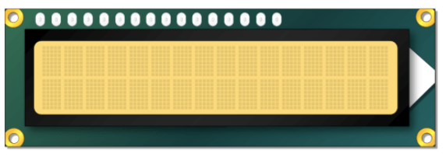
Lab12
Basic 1: (30%) Login system
Use LCD, Keypad, Tone, and RGB LED.
Use Keypad to enter the passcode. The input passcode’s length is <= 9. Default is ‘8080’.
Initial state: print ‘Input:’ on the first line of the LCD and wait for user input.
Print the passcode immediately on the LCD after ‘Input:’ when the user presses the keypad.
Create a task ‘taskKeypad’ to handle the keypad.
Initial state
While typing
Input:
Input: 123

Slide 5
Lab12
Basic 1: (cont.)
When ‘#’ is pressed, check the passcode (don’t print ‘#’).
If correct, print ‘Correct’ on the first line of LCD.
Else, print ‘Wrong!’ and the wrong passcode.
After 1 second, clear the LCD and go back to Initial state.
Correct result
Wrong result
Correct
Wrong! 1234
Initial state
After 1 second,
clear the LCD
After 1 second,
clear the LCD
Input:

Slide 6
Lab12
Basic 1: (cont.)
When the passcode is correct, turn on ‘Green’ light and ring the tone: tone(buzzer, 500).
After 1 second, turn off the light and mute the tone.
When the passcode is wrong, turn on ‘Red’ light and ring tone: tone(buzzer, 1000).
After 1 second, turn off the light and mute the tone.
Create another task ‘taskLEDTone’ to handle tone and RGB LED.

Slide 7
Lab12
Basic 2: (50%)
Extend from Basic 1 by adding the RFID reader.
When RFID reader detects a card, print the card UID on the first line of the LCD after ‘Input:’. UID is 8 digits long.
Check the card UID. If you use your own card, print ‘Correct’ on the first line of LCD, else print ‘Wrong!’ and the wrong UID.
Turn on RGB LED and tone as in Basic 1.
After 1 second, clear the LCD, turn off the light, mute the tone and go back to Initial state.
Initial state
Input:
Detect RFID card
Wrong! 22DCB36B

Slide 8
Lab12
Basic 2: (cont.)
Add a task ‘taskRFID’ to handle the RFID reader.
Use interrupt to detect the presence of a RFID card. Your ISR does nothing but to invoke taskRFID.只能喚醒RFID Task
Check MinimalInterrupt .ino
Now, you have two inputs to access the LCD.
Use a mutex to control which task can write into the buffer for the LCD. Do not use queues.
mutex保護lcd，誰抓到Mutex才能寫lcd

Slide 9
Lab12
Basic 3: (20%)
Extend from Basic 2 to find out the flag in the TA’s card and print it on the LCD, where the flag’s length is <= 16 and begin with 0x64:
Hint:
Use mfrc522.PCD_StopCrypto1() to access the block many times.
Use readblock(sector, block, buffer) to find the flag.
The sector range is 0~15 and the block range is 0~2, so you will find the flag between these ranges.
The value save in the buffer is hex type, change it to char type for printing on the LCD: char h = (char)buffer[i];
Wrong! 22DCB36B
d@ XXX XXX XXX

